Slide 1
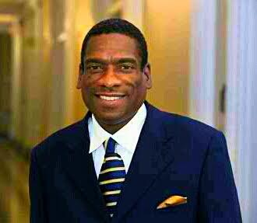
Thabiti Boone President Obama’s White House Champion For Fatherhood The University of Akron’s Annual Black Male Summit Summit County Fatherhood Initiative Presents The Role of Fathers in the Development of Black Boys Friday, April 8, 2016

Slide 2
Why Fatherhood? Why President Obama?
Watch ”President Barack Obama's Speech on Father's Day" on YouTube
https://youtu.be/Hj1hCDjwG6M
Fatherhood is a personal issue for all of us, our children, our Families our Communities, our Country.
No greater voice than the voice and Platform of the President.

Slide 3
The Fatherhood Landscape
Why is it important to discuss the Need and Role of our Fathers!!
Approximately 80% of Men in the world will become biological Father's at some point in their lives, and virtually all men have some connection to children.

Slide 4
The Father Absence Crisis in America
Over 24 million children, 1out of 3 live in biological Absent Homes, 2 in 3 African American Children live in homes absent biological fathers.
Children in Father Absent Homes are nearly 4 times more likely to be poor.
71% HS Dropouts from Fatherless Homes
85% of all youths sitting in prisons grew up in Fatherless Homes.
Boys who grow up in Father Absent Homes are challenged with Masculinity, Behavioral issues, Academic Performance, Difficulty Bonding, Emotional Stability, Peer Pressure

Slide 5
The Pain of Black Boys The Impact of Father Absence on Black Boys
"How Come He Don't Want Me!!”
Rejection
Abandonment
Emptiness
Vulnerability
Isolation
Sense of Self and Purpose Comprised
Emotionally Handicapped
Difficulty Bonding and Thriving
Mental Health becomes damaged
https://www.youtube.com/watch?v=AgkqTFasfmA&feature=youtu.be
When Father's are absent, Boys become dependent on external support systems.

Slide 6
Black Boys At A Crossroad
6
Black Boys are the most targeted, studied Subjects in the world!!
Fatherless Generation
1 in 3 Black Boys will spend some time locked up
Only 10% of 8th grade Black Boys considered proficient in reading
School to Prison Pipeline
Over 50% Dropout Rate
Overly represented in special education, suspensions, ADHD
leaders in homicide rates
Unemployable
Quality of Life is severely lowered
Achievement Gap is Widened

Slide 7
President Obama Platform to Address Fatherhood & Young Boys of Color!
"Our Children don't need us to be superheroes...they don't need us to be perfect...They do need us to be present...they need us to show up and give it our best shot...no matter what else is going on in our lives...they need us to show them, not just with words, but with deeds, that they, our kids, are always our first priority” President Obama On Fatherhood!
"I can see myself in these young men...these young men are more than 6x more likely to be victims of murder than their white peers and account for almost half of the country's murder victims each year...I'm launching on a new initiative to help more young men of color facing especially tough odds to stay on track and reach their full potential“ President Obama MBK!

Slide 8
President Obama Fatherhood Mentoring Initiative
Close the Gap on Father Absence
Elevate the Important need of Father's
How do we Foster the next generation
Raising Awareness
Partnerships
Advocacy/Policy/Funding Streams
Celebrating Fathers!!!

Slide 9
President Obama My Brothers Keeper
Intentional Focus: Advancing the needs and opportunities for Young Men of Color through the importance of mentoring.
My Brothers Keeper targeted Six Milestones:
1. Entering School Ready to Learn
2. Reading at Grade Level by 3rd Grade
3. Graduating from HS ready for college and career
4. Completing Postsecondary Education and Training
5. Successfully entering the workforce
6. Keep Kids Safe, on Track, Given A 2nd Chance

Slide 10
5th Grade Black Boy stood up in class, Stated Emotionally!! "I don't have a Dad!!!"
Can Fatherhood and Mentoring Work Together...should there be an either/or…?
The Challenge and The Good News!!

Slide 11
The Role of Father's in the Development of Black Boys
"There's something incredibly special when a Son Can look at his Father and See the reflection of himself, his possibilities and his Future”
https://youtu.be/e1LzQUxVo_M
Father's are:
(Unique) Intrinsic Caregivers
Present, Involved, Engaged
#1 Influencers on Boys well being
Play Significant Role as Provider
Concerned about their Children
Equally loving towards their children
Father's have to make their son's and children feel loved, wanted, cared for.
Father's are the driver's of their Son's aspirations, goals and dreams!!!
The quality and quantity of time a Father spends with his son makes a difference in a healthier outlook on life.

Slide 12
Father's Provide Boys With:
Modeled Behavior & Character
Defined Manhood
Emotional, Social, Intellectual Stability, Encouragement
Stable Consistent Attachment
Sense of Safety and Security
Guidance and Support during each Maturation phase
Identity, Purpose, Awareness
Spiritual Foundation

Slide 13
Outcomes for Black Boys:
Boys Thrive Stronger with Father's
Boys Masculinity are more Secure
Boys more Gender equitable
Higher Aptitude for Achievement
Increase Healthier Quality of Life
Better Choices, Peer Pressure
Strong Character, Leadership Skills

Slide 14
The Most Important Phase of a Father's involvement with Black Boys!!
Birth to Early Childhood Development
Most Critical Bonding Period
Increases continued involvement
Hormonal Changes/Physical Contact
Boys increase Healthier outcomes
Lasting Benefits for Father and Son
Reduces Infant Mortality Rate
Enhances Cognitive Development

Slide 15
Benefits of Father's Involvement
Father's involvement has been linked to healthier pregnancy outcomes, higher cognitive development, better relationship with the child's mother, etc
Becoming a father pushes men to lead healthier lives, have healthier bodies, a healthier state of mind, outlook on life.
Men are happier father's when they are supportive, involved and engaged.
Father's who demonstrate a close connection with their children live longer, have fewer mental, physical health problems, less likely to abuse drugs, more productive in society.

Slide 16
*How Do we support Father's in the Development of Black Boys!!
Promote Value of Father's
See Father's as Equal Partners
Improve Father's Rights
Support Capacity of Services
Strengthen Policies
Eliminate Barriers
Father Friendly Society

Slide 17
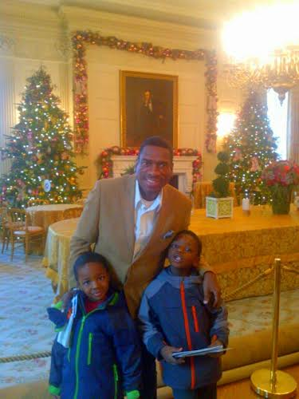
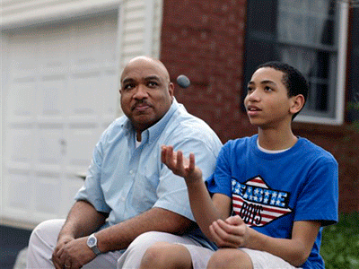
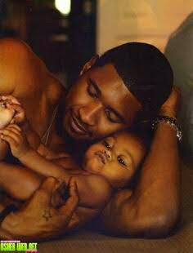
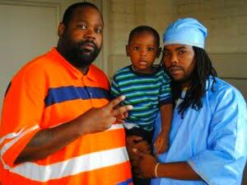
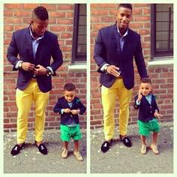
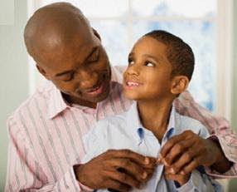
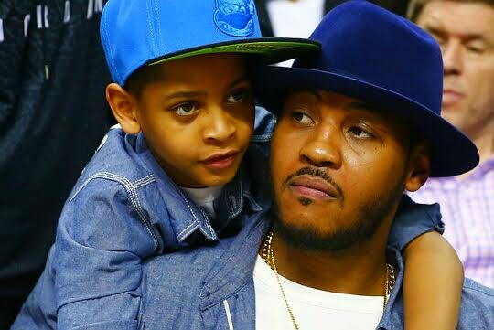
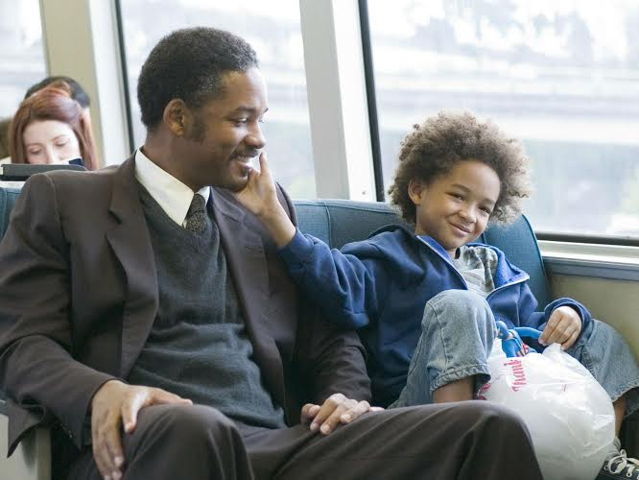
What Stories we want told about Father's and Black Boys!!!
Black Boys Lives Depend on All of us, but Most Importantly their Father's!!

Slide 18
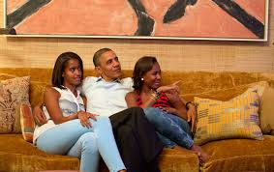
President Obama
"Over the Course of my life, I have been an attorney, I've been a professor, I've been a State Senator, I've been a US Senator, I'm currently the President of the United States, But I can say without hesitation that the most challenging, most fulfilling, most important job I will have during my time on this earth is to be Sasha and Malia's Dad.”
https://youtu.be/Tz28tO2IIeM

Slide 19
Q & A
Hearing From You!!!

Slide 20
Thank You!!!

