Slide 1
MAN THE BLOCK CITYWIDE – MAY 16, 2016
Dr. Marco Clark, Founder & CEO, Richard Wright Public Charter School May 2, 2016
Notes:
This template is in widescreen format and demonstrates how transitions, animations, and multimedia choreography can be used to enrich a presentation.

Slide 2
In Partnership With:C
Notes:
This slide can be used as a background before the presentation begins.

Slide 3
Working Together To Create Safe Passage
City Government
Community
Schools

Slide 4
Man The Block – The History
Since the doors opened to students in 2011, Richard Wright Public Charter School began implementing the Man The Block Richard Wright Safe Passage Program on a daily basis. Founder, CEO, and Head of School, Dr. Marco Clark, understood the importance and need of connecting communities with schools to create safe environments for children to learn and be successful. The Richard Wright Safe Passage Program was created to provide Safe Passage to and from school by concerted efforts of staff, parents, and volunteers in the community to escort students to metro and bus stops each day.
In 2015, after having implemented the Man The Block Richard Wright Safe Passage Program with success through before and after school posts, as well as bike and pedestrian escorts teams, the Man The Block initiative was expanded through the combined efforts of the Omega Psi Phi Fraternity, Inc. to reach out to the other organizations such as 100 Fathers, Inc., The Honorable Man Campaign, and the Promise Program, to bring attention to the need for concerned individuals and community members to unify and work together to provide encouragement, support, and safety for children traveling to and from school. Hundreds of men of different generations, professions, and backgrounds came out to escort students from school to the metro to ensure safety, deflect harassment, and deter crime and violence, while building relationships and increasing mentorship opportunities.

Slide 5
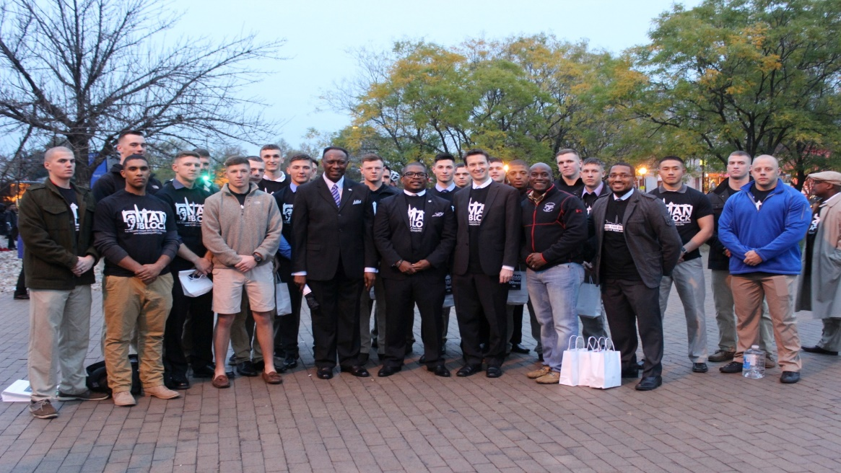
Man The Block II
Due to the success of the first Man The Block Initiative in August 2015, Man The Block Part II expanded to include 5 public charter schools in Southeast, Northeast, and Northwest. From strong support and partnership with the Omega Psi Phi Fraternity, Inc. and 100 Fathers, Inc., collaborating schools hosted events at their respective schools and increased community awareness and advocacy around the city. The participating schools along with parents, men and women from various civic organizations, businesses, colleges, DC Councilmembers, DC representatives, and the U.S. Marines, came together to demonstrate and model what communities can achieve by working together in order to create encouraging environments for our youth all over the city.

Slide 6
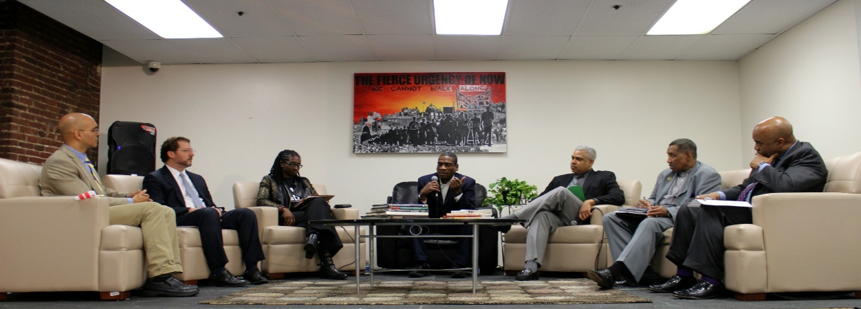
Man The Block III – The Symposium
Man The Block hosts events quarterly to maintain community awareness and involvement to help create positive and meaningful solutions to the provide Safe Passage for all children in communities. Man The Block The Symposium was held in February of 2016 with a an esteemed panel and moderator to discuss with the community various aspects of the importance of working together across the District. With strong support from Councilmember Grosso, Councilmember Allen, and Councilmember May, as well as the DC Public Charter Board and the Deputy Mayor’s Office of Education, Man The Block CITYWIDE was planned to generate awareness and participation from all sectors across the District. Most recently, the DC Office of Cable Television, Film, Music and Entertainment (OCTFME) has become a strong partner with Man The Block to spread the word that the need for Safe Passage and for overall community involvement is now.

Slide 7
Man The Block Safe Passage Mission
To promote Safe Passage for all students in the District of Columbia through coordinated and collaborative efforts of schools, city government, civic organizations, and whole communities.

Slide 8
Man The Block Safe Passage Goals
• Engage schools, community, government, and businesses in collaborative solutions
• Continue to build productive, clean, and safe communities around institutions of learning
• Promote academic achievement
• Promote clear walkways (free of loitering, harassment, bullying, drugs, and alcohol)
• Increase the number of bike lanes near educational institutions

Slide 9
Man The Block CITYWIDE – may 16, 2016
Man The Block CITYWIDE on Monday, May 16, 2016 is an opportunity to bring about awareness, advocacy, and participation around Safe Passage for all DC students, involving all sectors of community and government. Volunteers will support schools in each Ward as a unified, collective effort, serving as an impetus for momentous and needed action for positive change on various levels.
With the increase of violence that has surged in the District, a sense of urgency in preventive measures is needed in which community responsibility, civic duty, communication and collaboration between city, school, business, and community leaders, are essential in preemptive solutions, as well as an opportunity to model these actions for positive youth development.

Slide 10
MAN THE BLOCK CITYWIDE – GOALS
To create the visible presence of a multitude of concerned, caring and encouraging adults from various sectors of community, instilling a sense of safety, community, and citizenship across the District for youth
To promote greater awareness and address the need for a community call to action for Safe Passage for ALL DC youth
To model for young people positive youth development through community responsibility, participation, and collaboration throughout the city
To increase sustained volunteerism for schools around the city for Safe Passage

Slide 11
Volunteer Expectations and Guidelines for May 16th
Every volunteer must register at the appropriate registration station upon arrival and must sign a waiver to participate in the event
Volunteers will be given specific directives and post locations by School Hub Captains
Volunteers will be present to greet and encourage students as they are dismissed from their respective schools and maintain certain posts along the safe passage routes identified by the specific schools
Volunteers will serve as a strong visual presence of caring and encouraging adults
Disciplinary action is the legal responsibility of administrators and school staff, and volunteers must not engage in disciplinary action, nor attempt any physical intervention
If a volunteer incurs a problem, immediately inform the appropriate staff member
Volunteers should discuss any concerns directly and exclusively with the supervising staff
Volunteers shall exercise mature judgment in supervising children, and shall in all instances respect each student’s rights and privacy, and maintain confidentiality regarding students and families
Volunteers should be willing to perform the assigned tasks appropriate for the event, and If a volunteer doesn’t understand the task assigned, he/she should ask for a demonstration and/or clarification of an appropriate task

Slide 12
Q & A

Slide 13
Tasks in Need of Assistance
Online Registration Form
Data Collection

Slide 14
Group Work Sessions by Ward
Conversation with Students
Customer Service
Organizational Chart
Registration
Close Out

Slide 15
Share Out

Slide 16
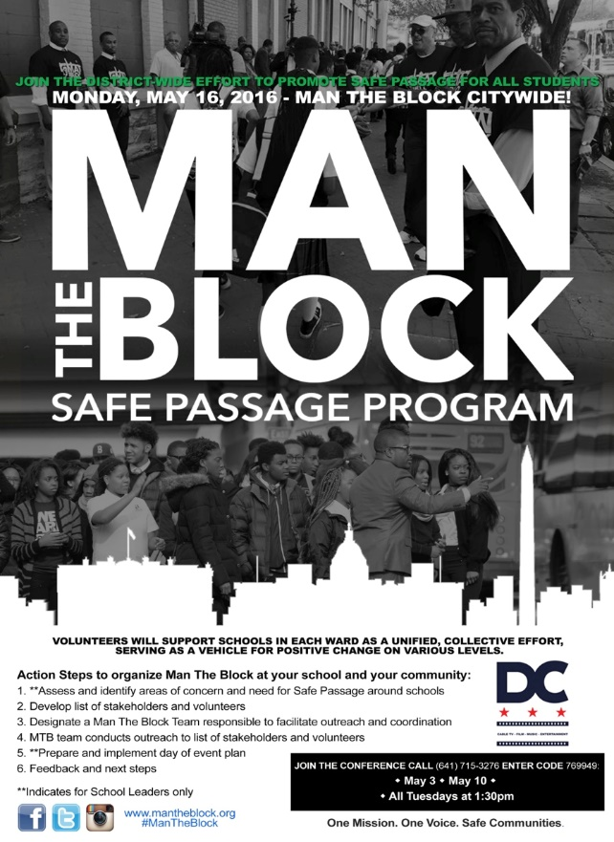
Next Steps

Slide 17
Man The Block CITYWIDE on May 16, 2016
We emphatically believe in creating safe and nurturing environments both in and out of school to ensure the highest level of quality education for all children. We thank you for joining together for this citywide effort creating collective change for all students in the District. Please continue to share the information with your network and direct others to the Man The Block website, Man The Block Facebook, and @4ManTheBlock on Twitter for updates.

Slide 18
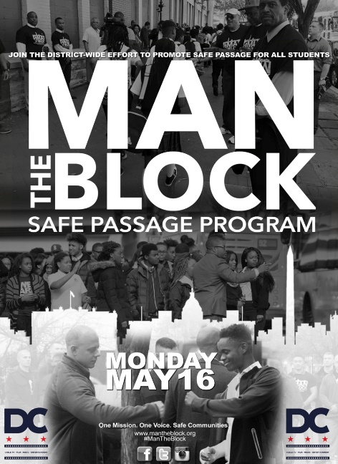
We are dedicated to creating Safe Passage for all students in the District…
so that our children can enjoy the same resources and beauty that One Mission. One Voice. Safe Communities.or generations.

